Slide 1
OC - Project 3
Conception of the App Nutristeph
Exploratory Data Analysis
Of a
Food Database
Stephane Lanchec

Slide 2
NutriSteph
Application that returns the Nutriscore & Nutrigrade of products
What’s new?
No need for a food database
Works for non-referenced products
Works for any product across the globe
Just take a picture of the list of ingredients on the product
Integrated algorithm: Ingredients Nutriscore/grade
Integrated dictionary/translator to grade any product in the world
Users language choice

Slide 3
App Scientific Process
USERS
DATABASE
Data cleaning
Nutriscore
PNNS categories
Nutrients
Nutrients
Products
PNNS Categories
Nutriscore
STEP 1:
Dummy Regression
R²
^{Coef.}
^{of determination}
STEP 2:
One Hot Encoding
Uni/Multivariate
Analysis
Statistical tests
Linear regressions

Slide 4
Dataset Overview & Cleaning

Slide 5
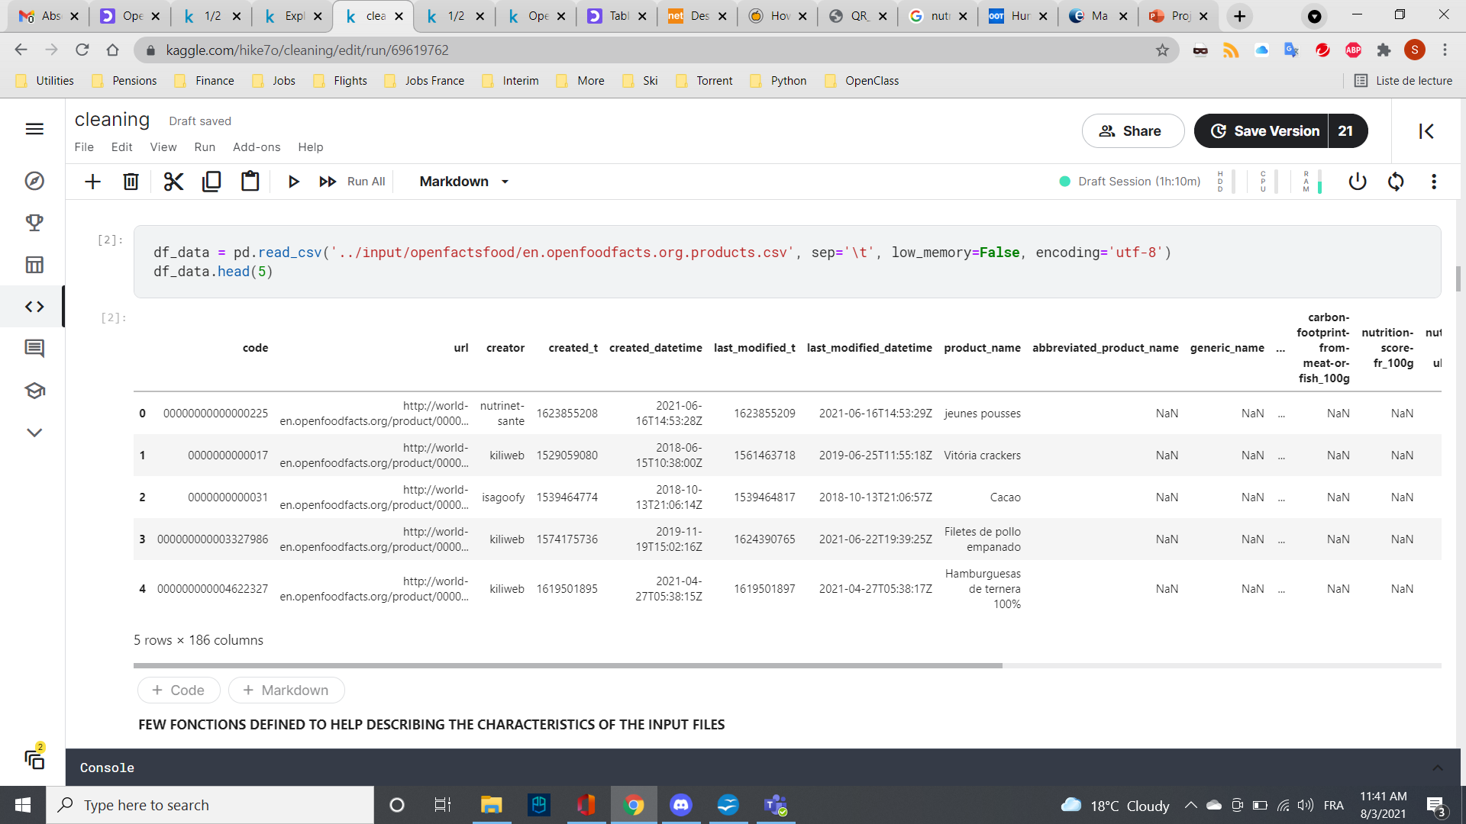
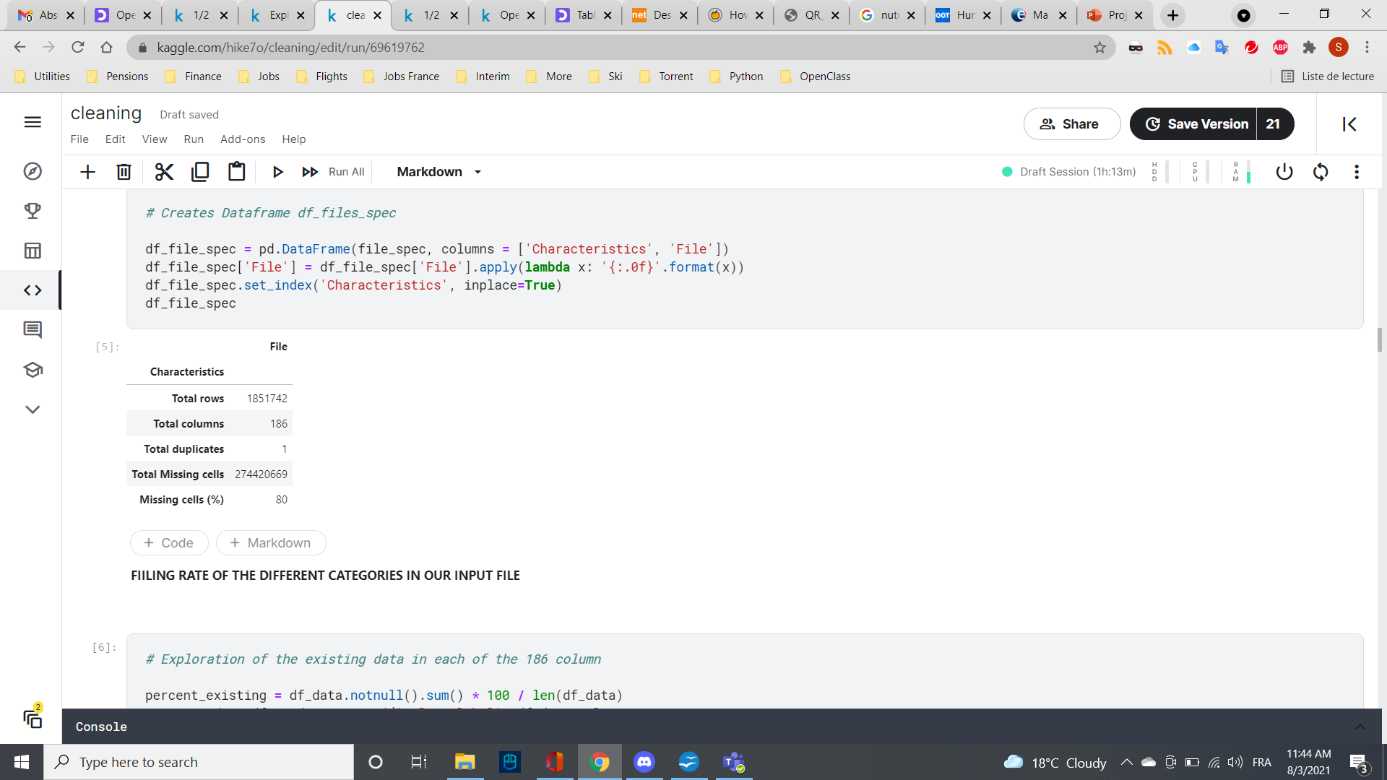
Data set available
Loading the data into the dataframe
df_data = pd.read_csv ("OpenFoodFacts.csv")
df_data.head(5)

Slide 6
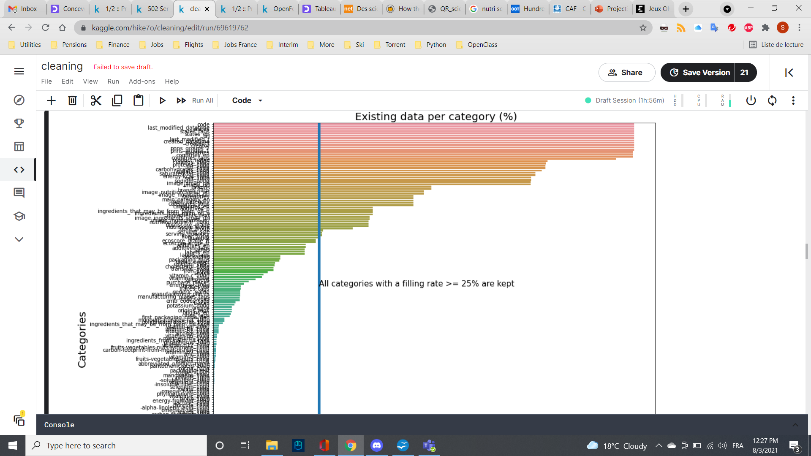
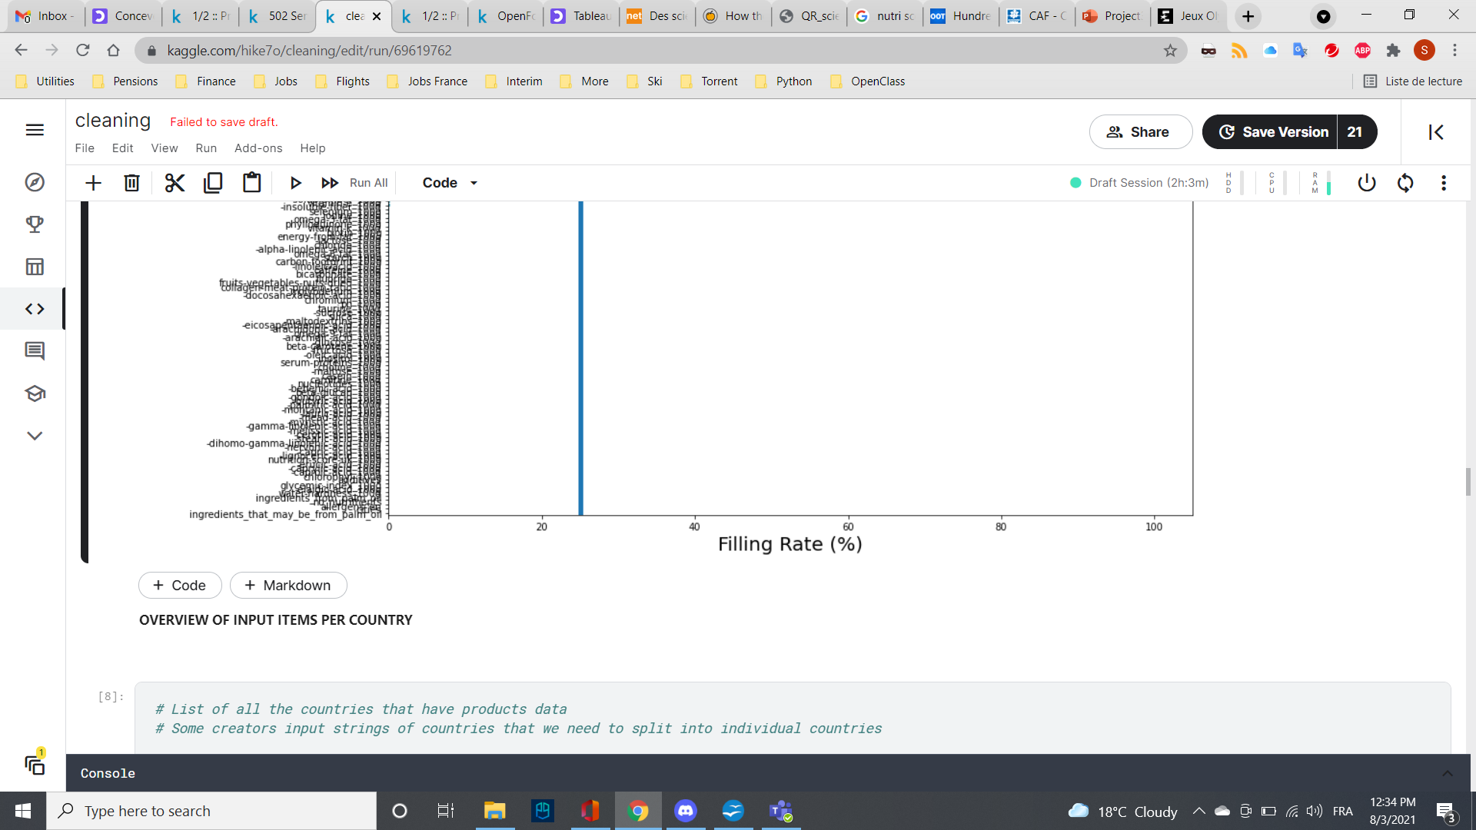
Data cleaning Phase 1: Filling rate
Removal of all columns with a filling rate < 25%
25% to keep Fibers category
Dataframe attributes reduction: 186 to 52

Slide 7
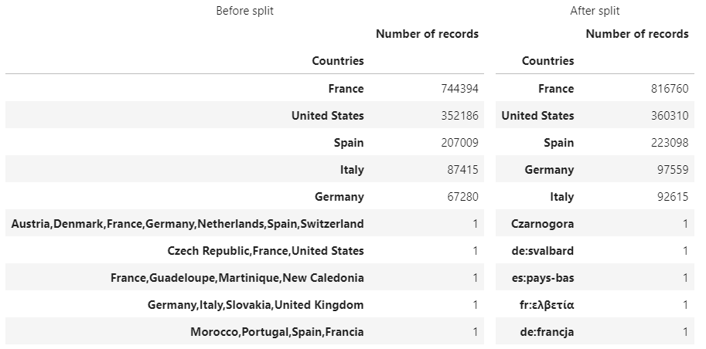
Data cleaning Phase 2: Country name
Different countries
Different input
Split strings by ",", stack and join
816k+ products in France
Dataframe tuples reduction 185k+ to 816k+
Focus on products available in France

Slide 8
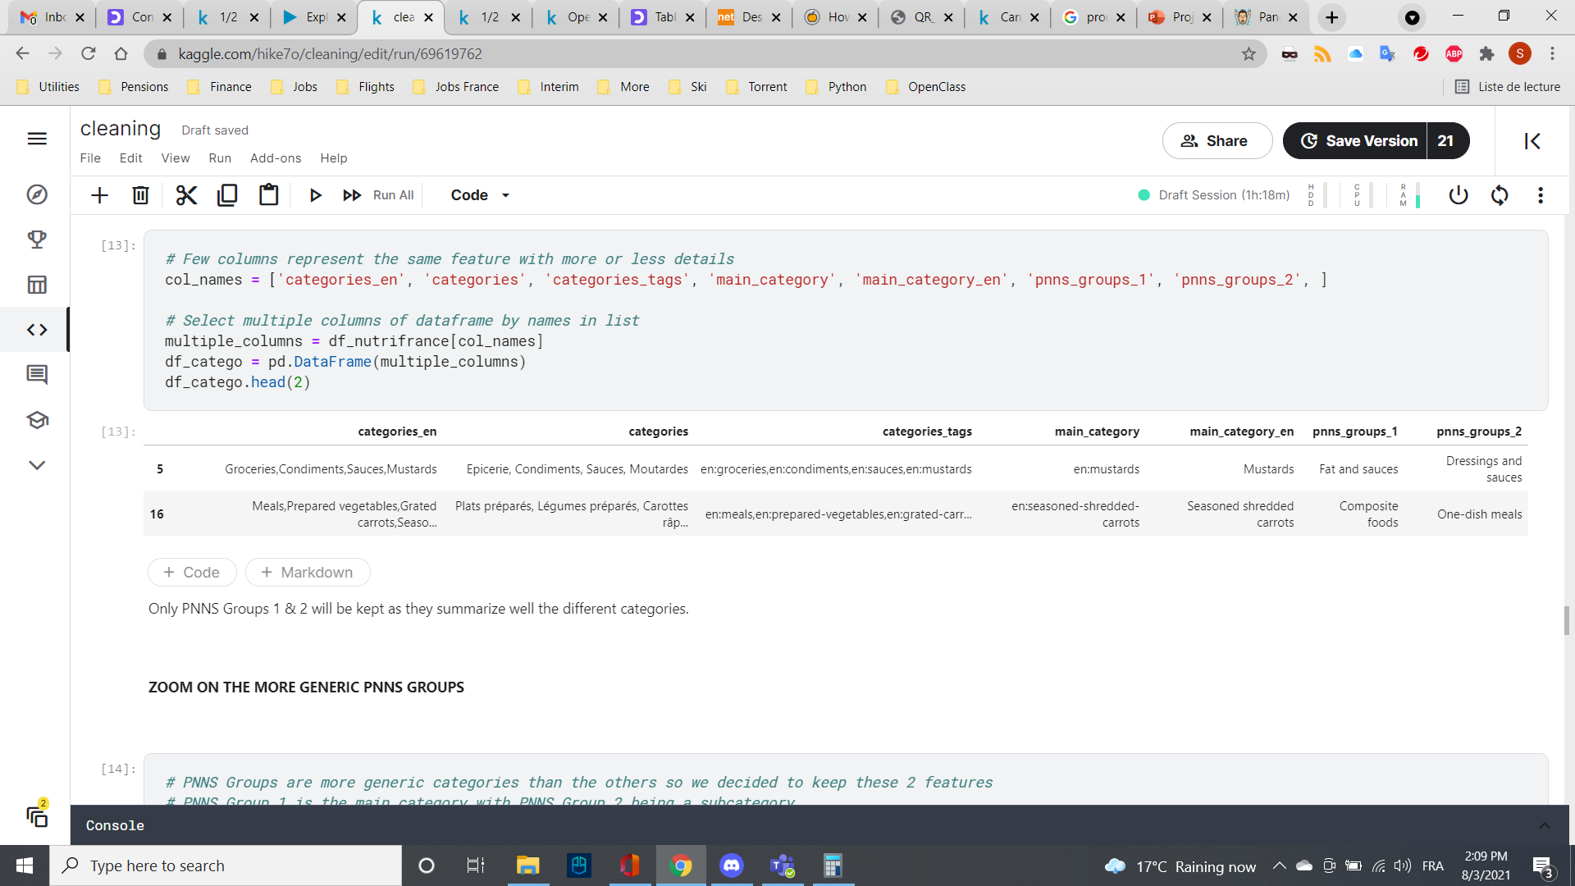
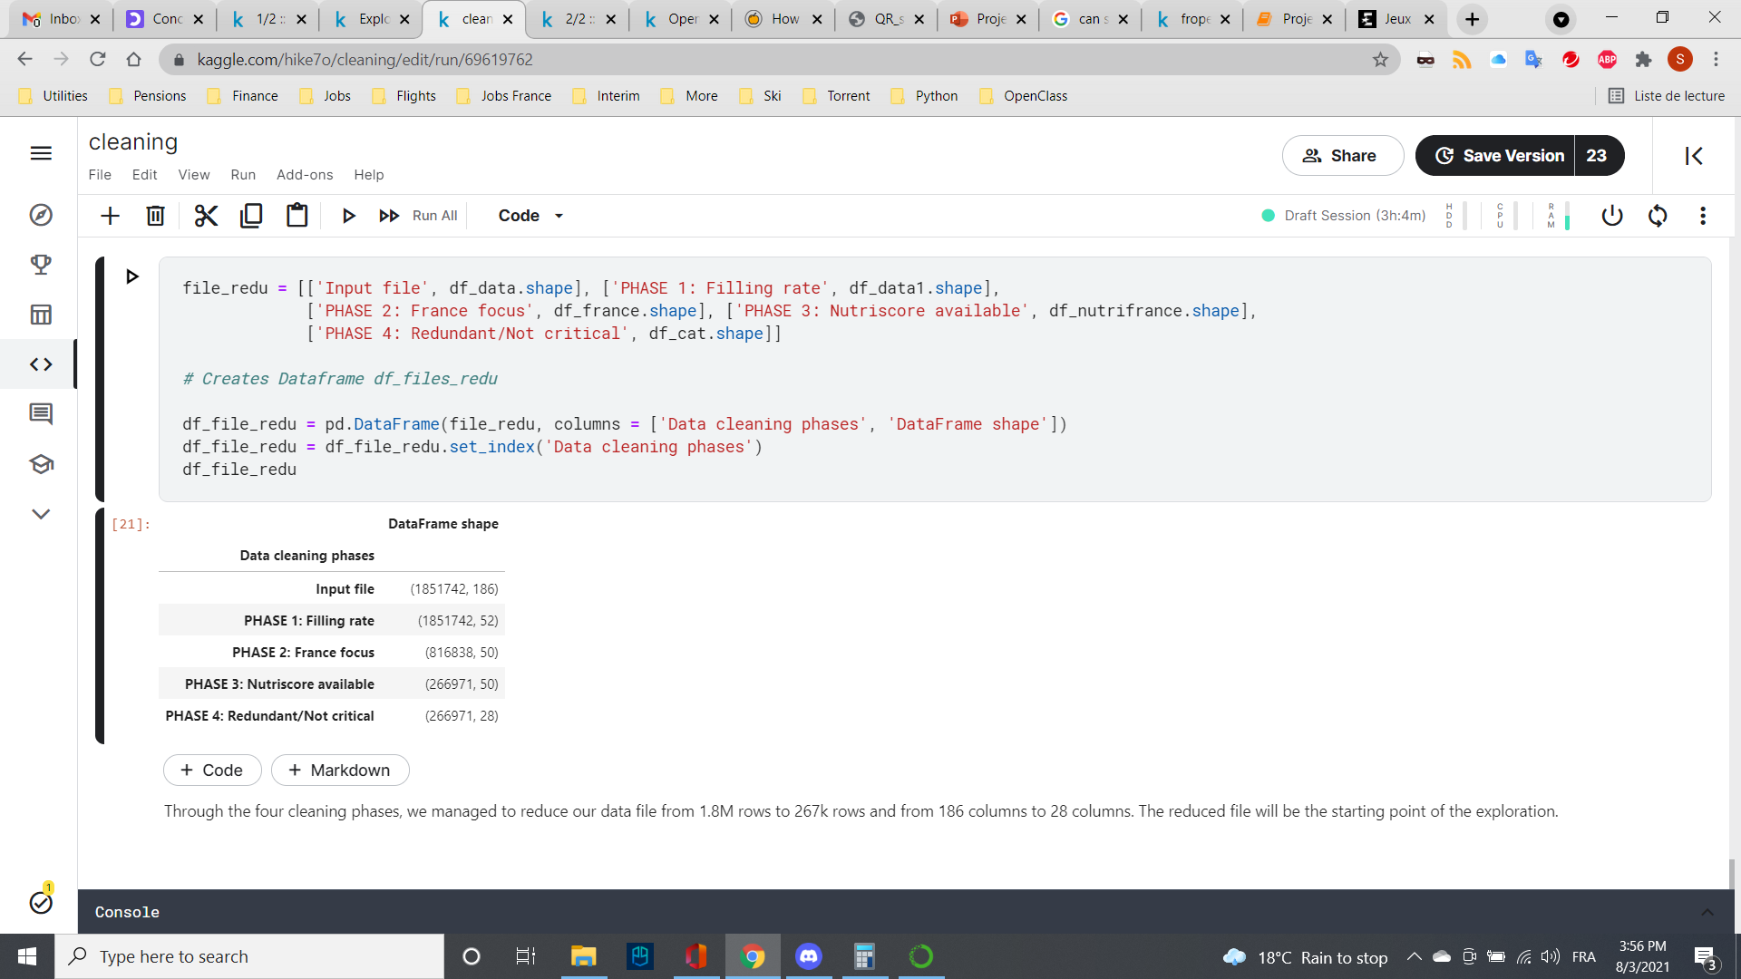
Data cleaning Phase 3/4
Focus on Nutriscore: Removal of all products with no Nutriscore information (Phase 3)
Removal of redundant products categories (Phase 4):
Removal of non-critical parameters:
additives_n
ecoscore_score_fr
created_t
….
created_datetime'
states_tags
Summary

Slide 9
Dataset Exploration

Slide 10
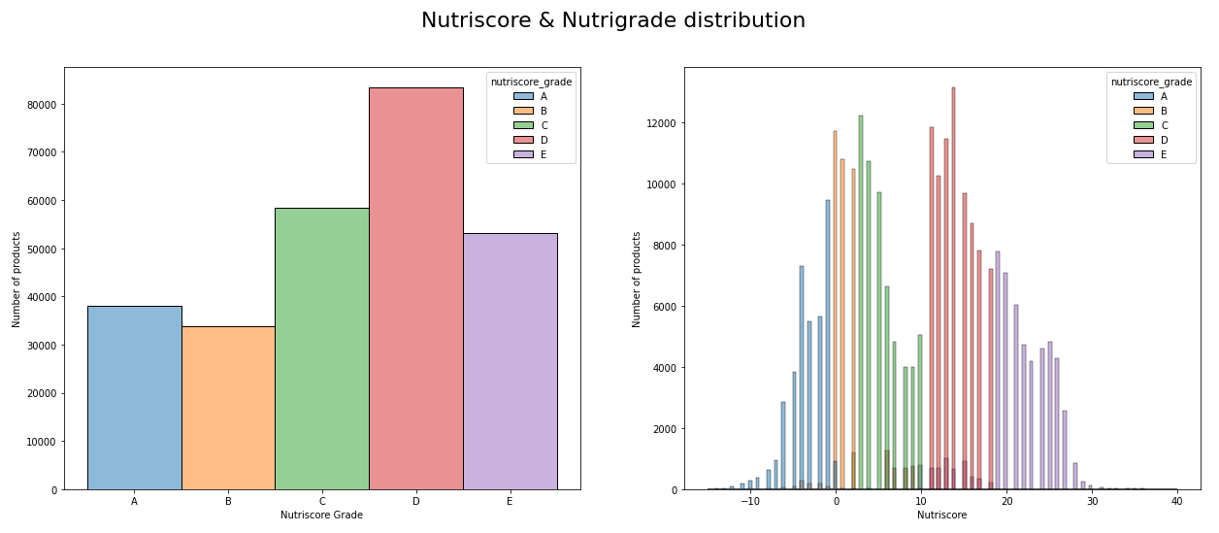
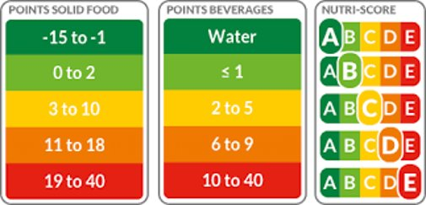
Products scoring and grading overview
Nutriscore
Database governed by
D grade products
Jbib
Gbugygu
gugyh

Slide 11
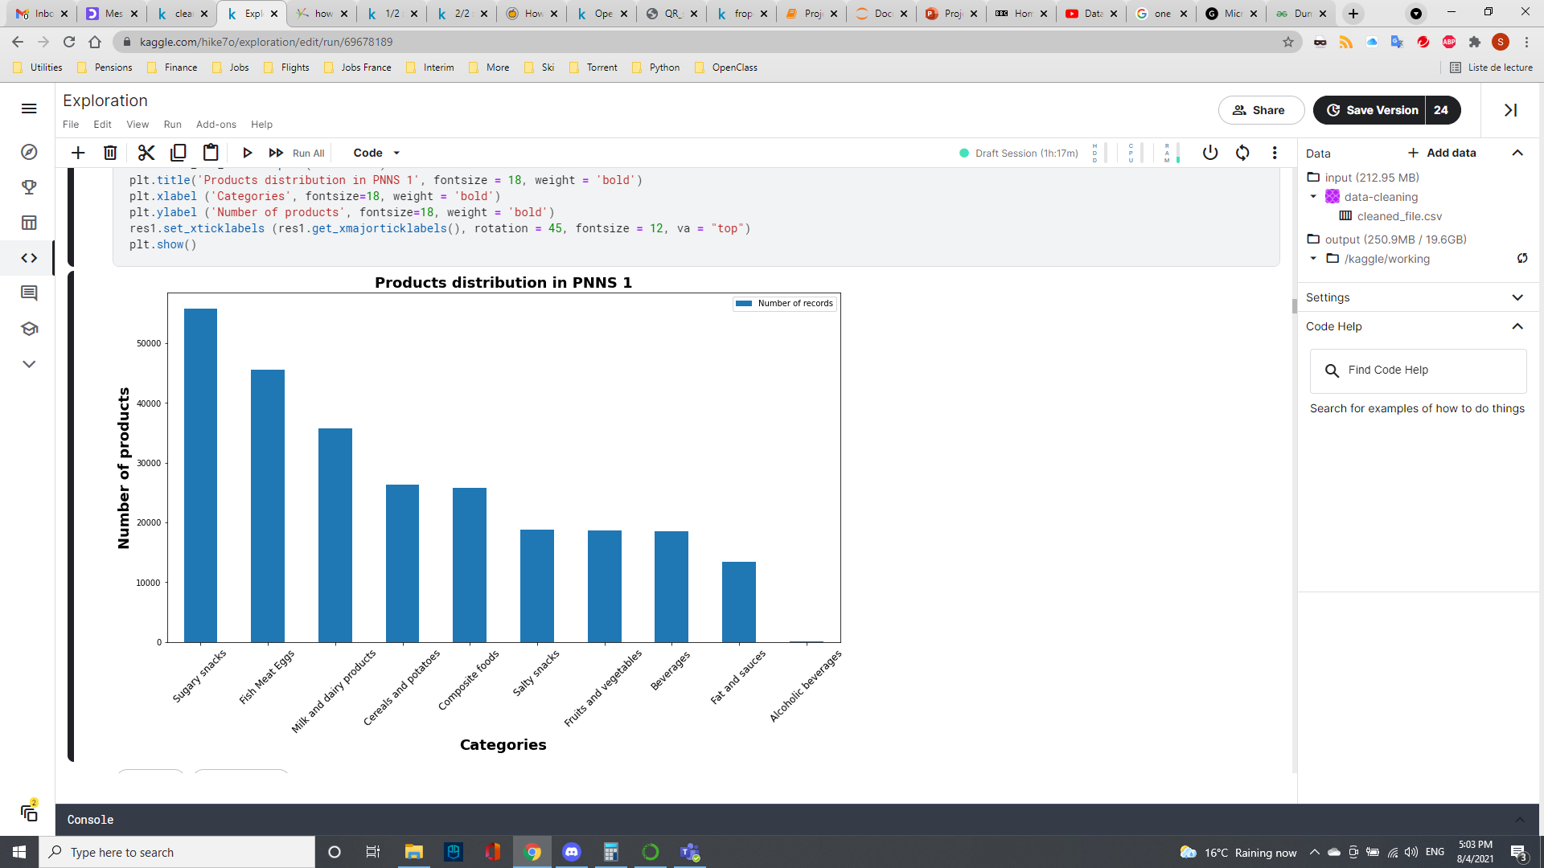
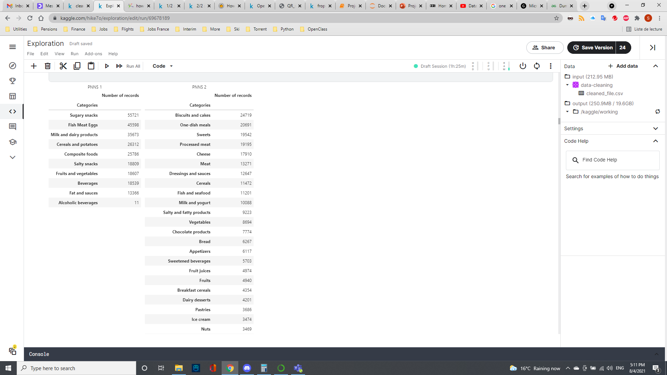
Products Categories Overview
PNNS 2
39 subcategories PNNS 2
Products are classified into 10 main categories PNNS 1
Most products are sugary snacks or Fish Meat Eggs
Each PNNS 1 category is divided into some of the 39 subcategories from PNNS 2
Hypothesis: Sugary snacks
.
.
.

Slide 12
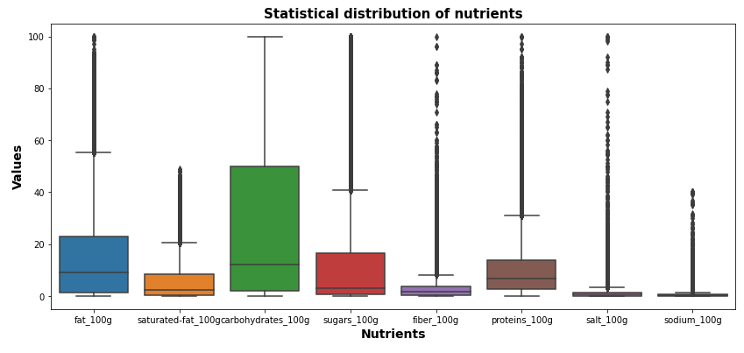
Nutrients distribution overview
Oil
Butter
Over 265k products
Focus on 7 nutrients:
Fat
Saturated fat
Carbohydrates
Sugars
Fiber
Proteins
Salt
Sodium
Powder
Protein shake
Chocolate
Sugar
Jam
Salt
Stock cube
Soja sauce
Chocolate
Foie gras
Cheese
Organic
Peas
Outliers:
Numbers:
>60
3,000
>20
7,000
>50
19,000
>5
18,000
>35
2,300
>5
7,000
Outliers represent a small fraction of the number of products
Some products are true outliers observations (sugar=100, salt=100…), some are input errors

Slide 13
Examples of erroneous data
Product | Brands | energy | fat | saturated-fat | carbohydrates | sugars | fiber | proteins | salt | Actual value
Boudins blanc | Maitre Coq | 3690 | 17 | 5.4 | 4.9 | 2.7 | 0 | 9.5 | 1.3 | 882
Pistaches grillees a sec | Rochambeau | 2523 | 49 | 49 | 11.3 | 6.4 | 0 | 24.7 | 1.7 | 6.7
Sauge des alpes | Ricola | 983 | 0 | 0 | 97 | 0 | 96 (value for polyols) | 0 | 0 | 0
Cream crackers | Morrissons | 1849 | 14.3 | 6.5 | 67.2 | 1.6 | 3.1 | 97 | 1.26 | 9.7
Californian almonds | Happy Belly | 2489 | 49.9 | 3.8 | 9.1 | 4.2 | 12.5 | 21.2 | 20 | 0.02
Typo errors by users
Values input by mistake
Difficult to sort them out so we decided to keep them

Slide 14
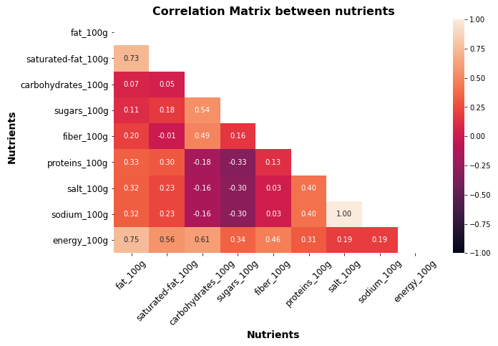
Correlation Matrix Heatmap
Perfect positive correlation
Salt & sodium
Strong positive correlation
Energy, fat and saturated fat
Relatively strong positive correlation
Carbohydrates & sugars
Medium positive correlation
Carbohydrates & fibers
Weak positive correlation
Proteins & salt/sodium
No correlation
Sugars & fibers

Slide 15
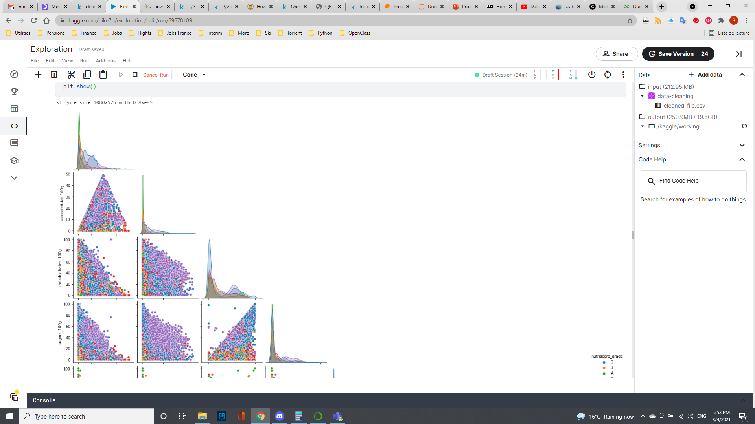
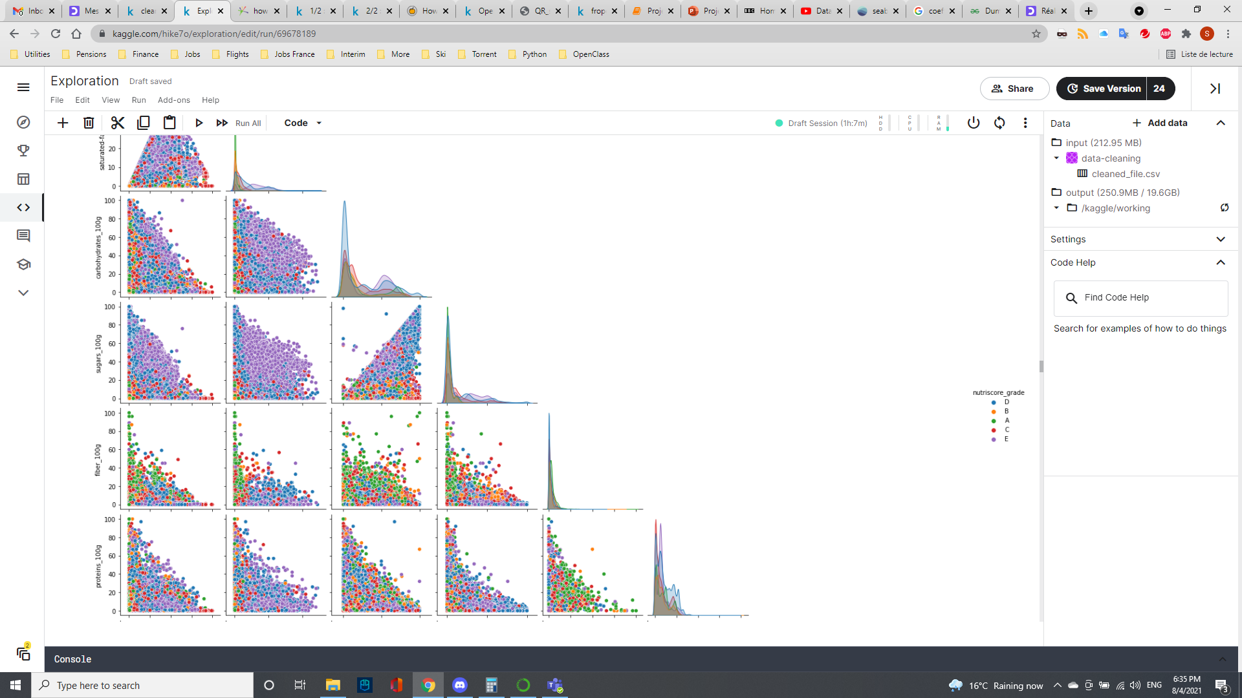
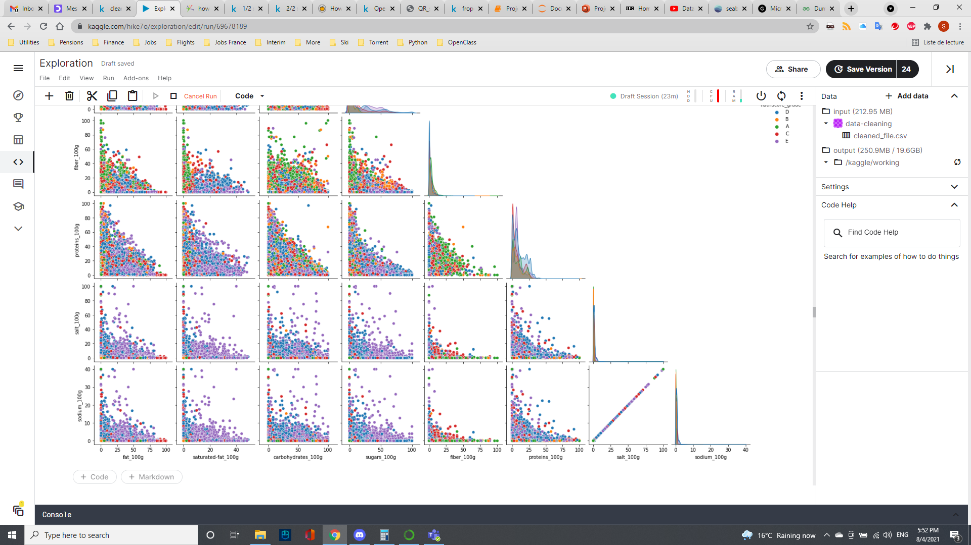
Multivariate Analysis

Slide 16
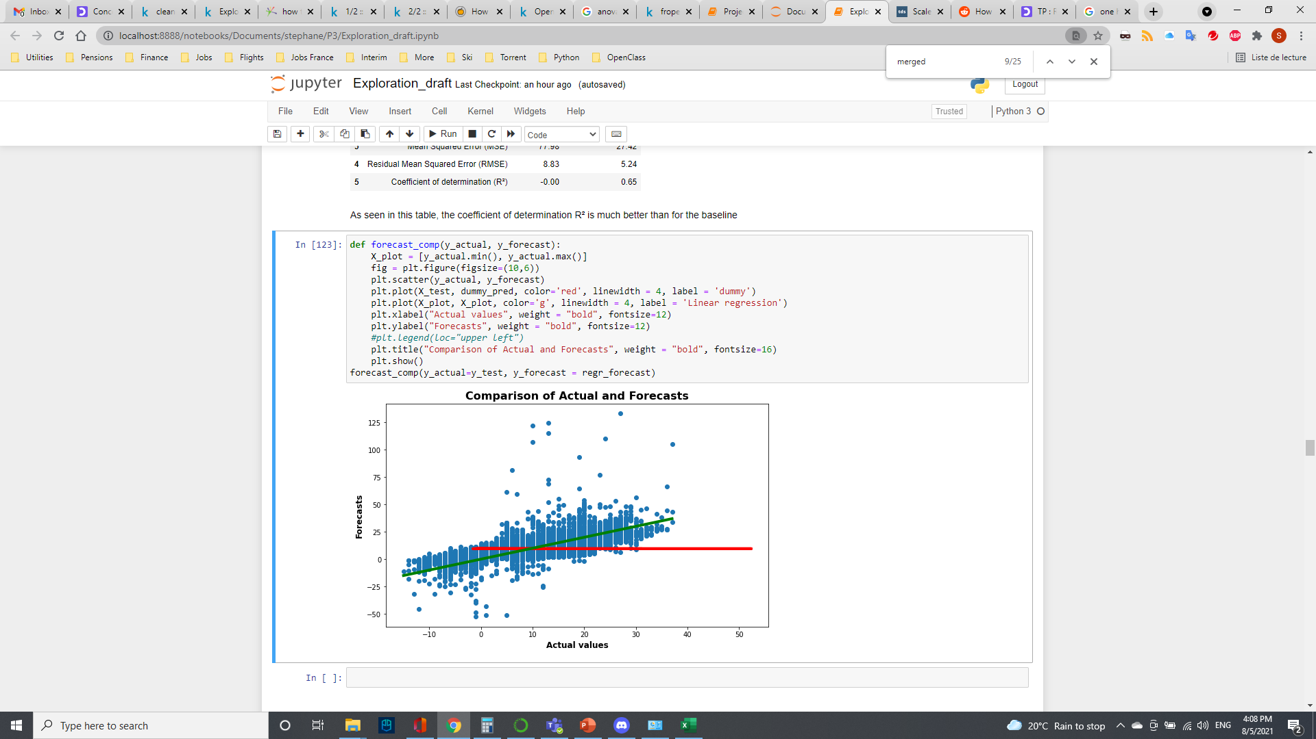
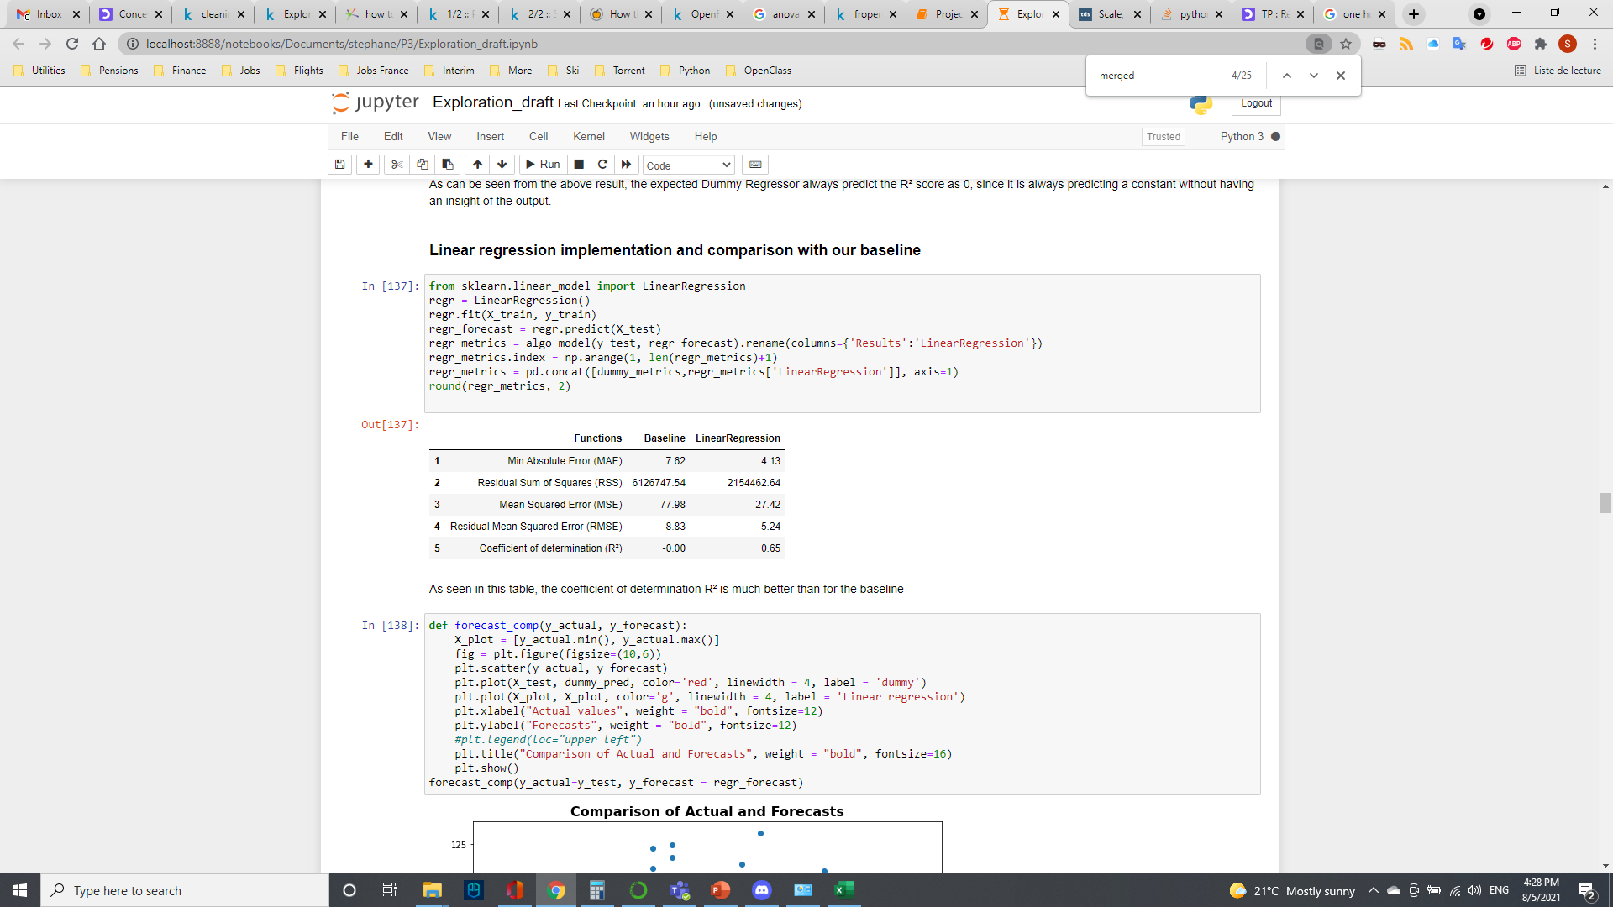
Multivariate linear regression
Linear regression vs. Dummy regression (baseline)
Coefficient of determination: how well the regression model fits the actual data
R2 = 0.65, scattered data between actual & forecasts
Linear regression
Baseline

Slide 17
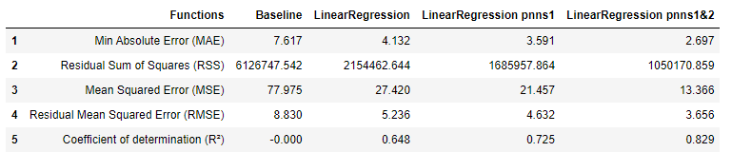
Second regression: One Hot Encoding
ANOVA performed showed PPNS groups have an impact on Nutriscore
Incorporation of categorical values PNNS Group 1 & 2 into regression
Increases the coefficient of determination to 0.83
Summary of the different regressions performed
One Hot Encoding

Slide 18
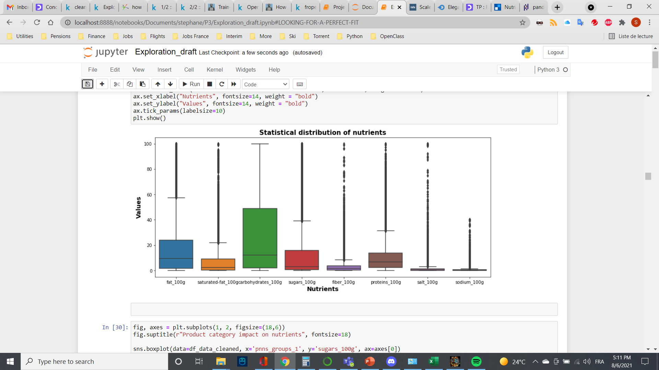
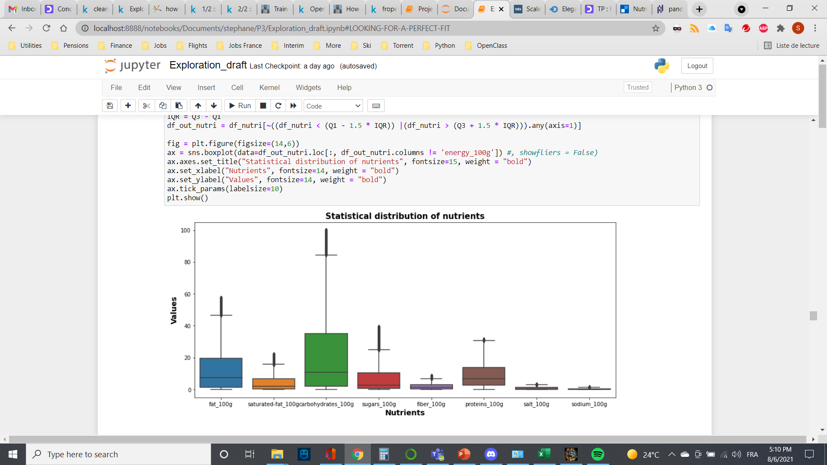
Outliers impact
Scattered data due to outliers
Interquartile range method

Slide 19
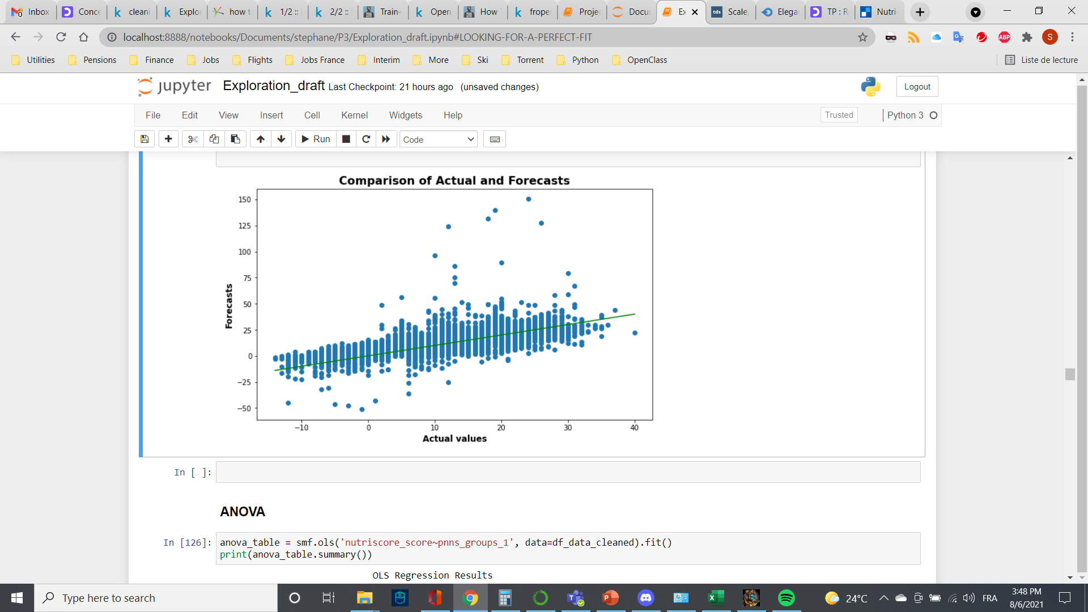
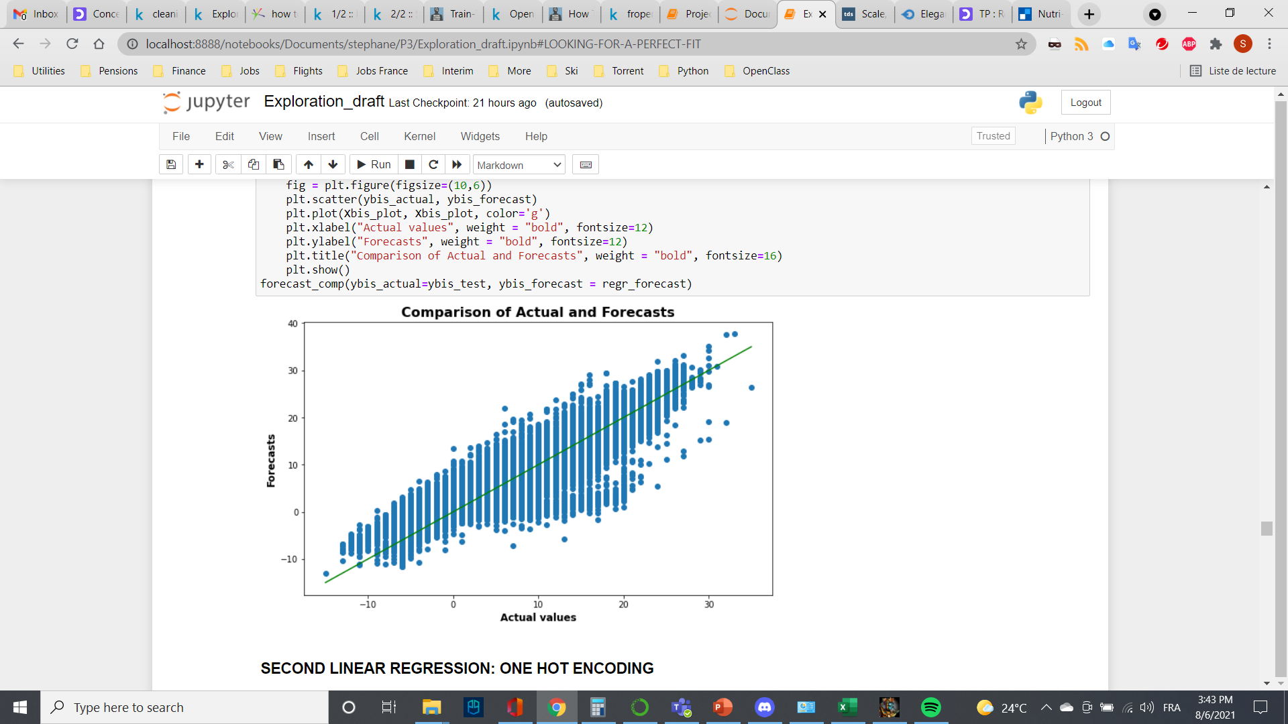
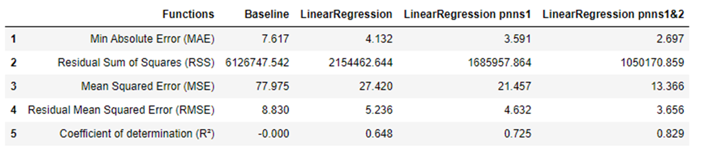
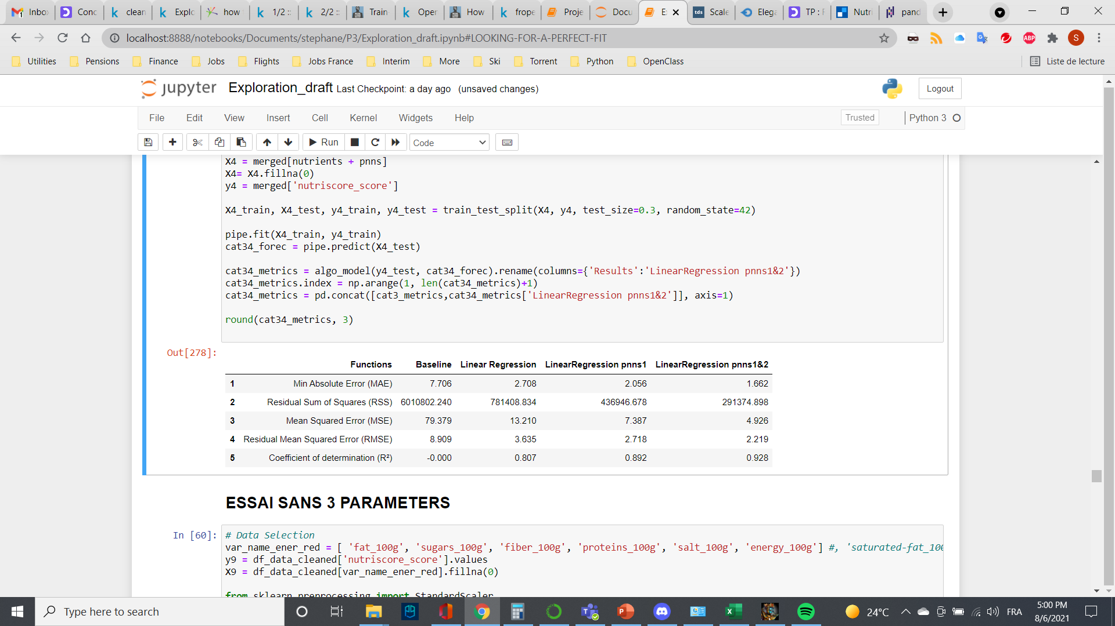
Regression improvement
With outliers R² = 0.83
Without outliers R² = 0.93

Slide 20
Discussions
Datbase In-depth cleaning

Slide 21
Conclusions

